Slide 1
Go on, say yes, and… design thinking made personal
Jeanine Spence
Experience Strategist
Current Associates & The SFE Group

Slide 2
Say yes, and…

Slide 3
hope for the best

Slide 4
or go on a designed journey

Slide 5
of discovery.

Slide 6


Slide 7


Slide 8
Design thinking reflection
Notes:
There are lots of talks on TED, lots of books about discovering yourself, finding a career path and so on. I’m not an expert in these areas, but I have spent years building design thinking centered teams, teaching and practicing design thinking.
Today I am sharing my experience applying design thinking to me. And what is the same and what is different about how it works for product or service.
I’ll share some examples, especially the challenges
And then we will take on an exercise together.

Slide 9
A story.
Notes:
This invitation came at a good time
This year I have been reflecting on some of the ways design thinking can apply to personal challenges

Slide 10

Notes:
Last year was one of big change at Microsoft. 18,000 people laid off, around 4,000 in the Puget Sound area which included my division.

Slide 11

Notes:
I really liked what I was doing, teaching design thinking to Engineers as part of the Scenario Focused Engineering initiative, 22,000 took the workshops, I coached and worked along side several teams. But what we were doing internally did not directly apply out in the wild. So now what.

Slide 12
Challenge assumptions.
Notes:
This is always a good place to start. And extra hard in the middle of a layoff.
After so many years working of software teams, I certainly had experience that applied to different job openings.
But what if I could do something different, work in a different way
But the pressure was on
Focus on your marketable skills
Read the job postings and bring out those experiences
Except wait, stop
That was the opposite of what I was trying to do.
That was the equivalent of writing a feature list without any idea of who the customer was. And to be honest, after reading 100 job postings, I’m not sure what those companies were thinking.

Slide 13

Notes:
This is how it felt when I thought about going back to the kind of job I held a decade ago.

Slide 14
Sit in ambiguity Find my new customer Uncover insights Not take the first paved off-ramp Discover something new Evaluate value propositions Handle constraints
Notes:
So what could design thinking help me with?

Slide 15

Notes:
When you are mid-career – there is a lot of digging to get to the big T truths about what you want to focus on
There are lots of assumptions to challenge, unwinding back years.

Slide 16

Notes:
And what would bring joy, what brings magic
Growing up in Alaska – the biggest mystery were the Northern Lights

Slide 17

Notes:
Generating lots of ideas

Slide 18

Notes:
Testing these, writing up a press release, or a profile, creating an elevator pitch and trying it out

Slide 19
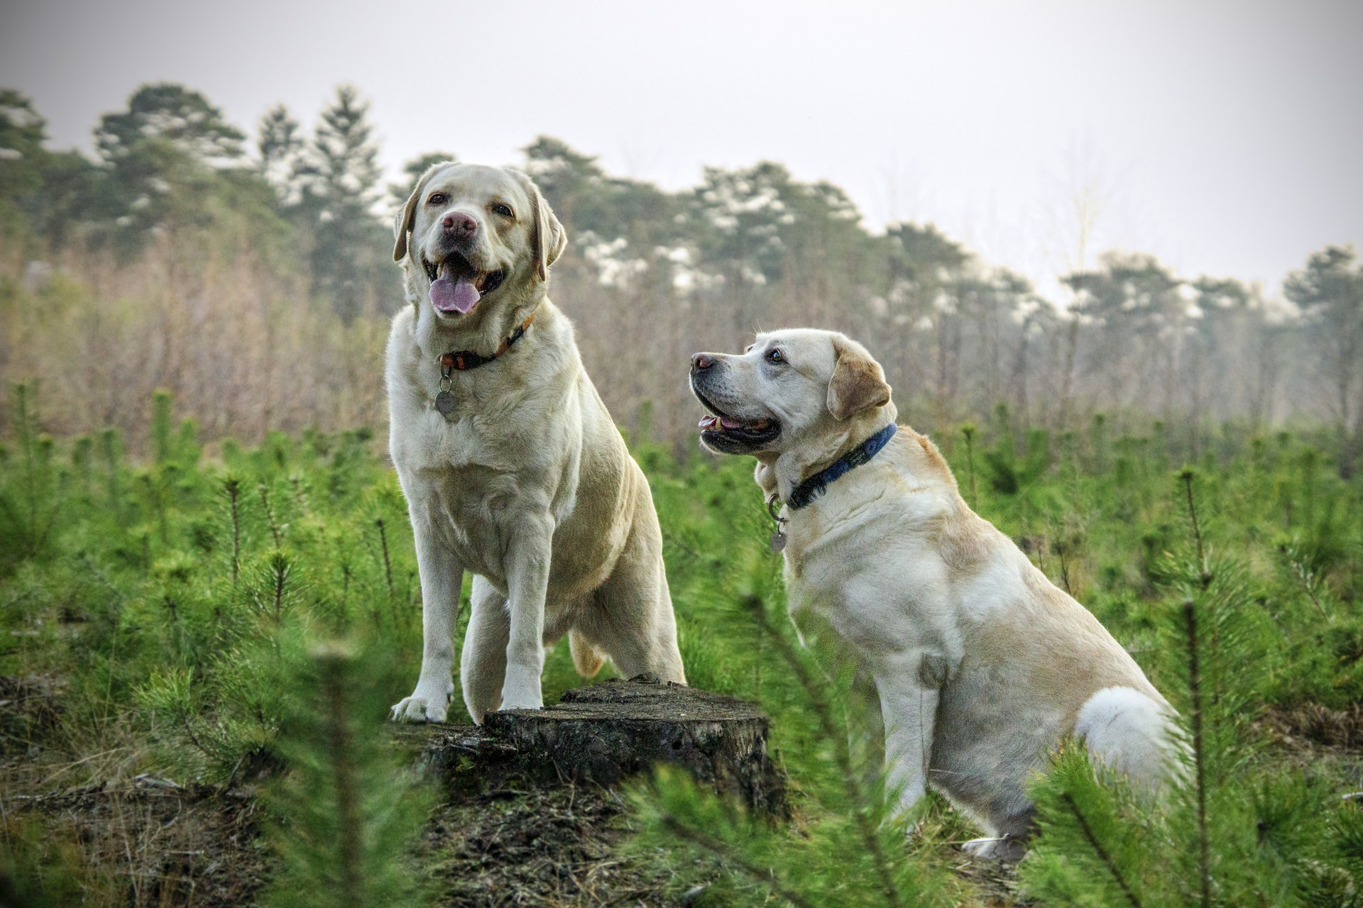
Notes:
Turns out friends and family are not good at giving feedback
They know you really well and bias to the familiar
They are not your customer

Slide 20
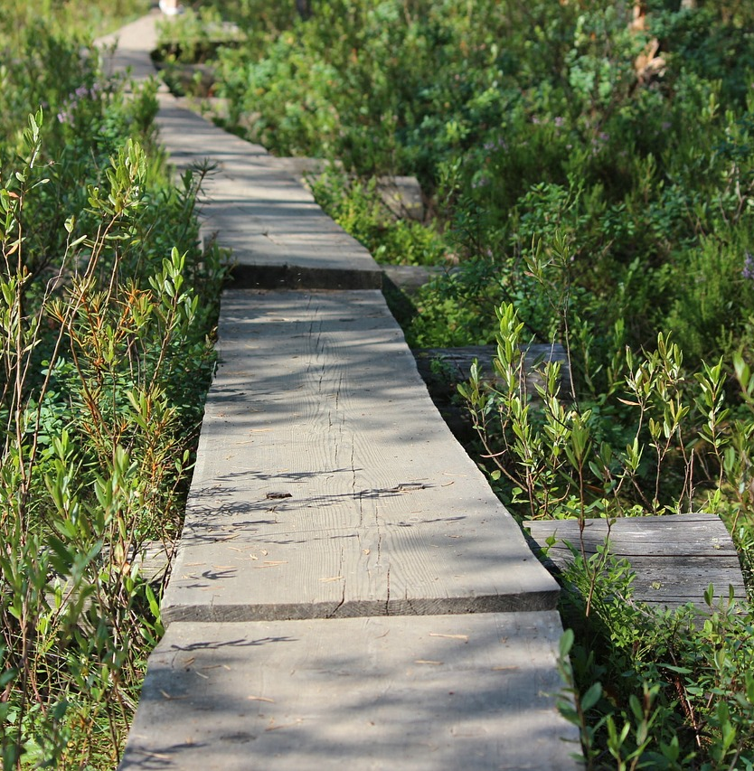

When faced with a challenge
Choice, go with the familiar or say yes and jump in
Notes:
Then as I tried out various options, a few started to take hold.

Slide 21
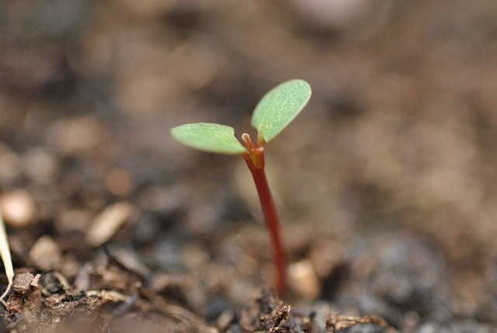
Notes:
And I found my direction

Slide 22

Notes:
But it was not an immediate clear path. But with the end goal, now the near team decisions are easier.
I’m not making a massive change all at once except for where I work.

Slide 23

Design Thinking
INSIGHT and FEEDBACK
FRAME with OUTCOMES
FOCUS
BUILD
BRAINSTORM

Slide 24
Design Thinking
Reflection, inspiration
Feedback
Reframing
Long term, short term outcomes
Diverging
Me
Press release, profile, elevator pitch
Wild ideas, new math

Slide 25
But, let’s focus on a simpler topic.

Slide 26
Take a new kind of trip.
Drew’s story.

Slide 27
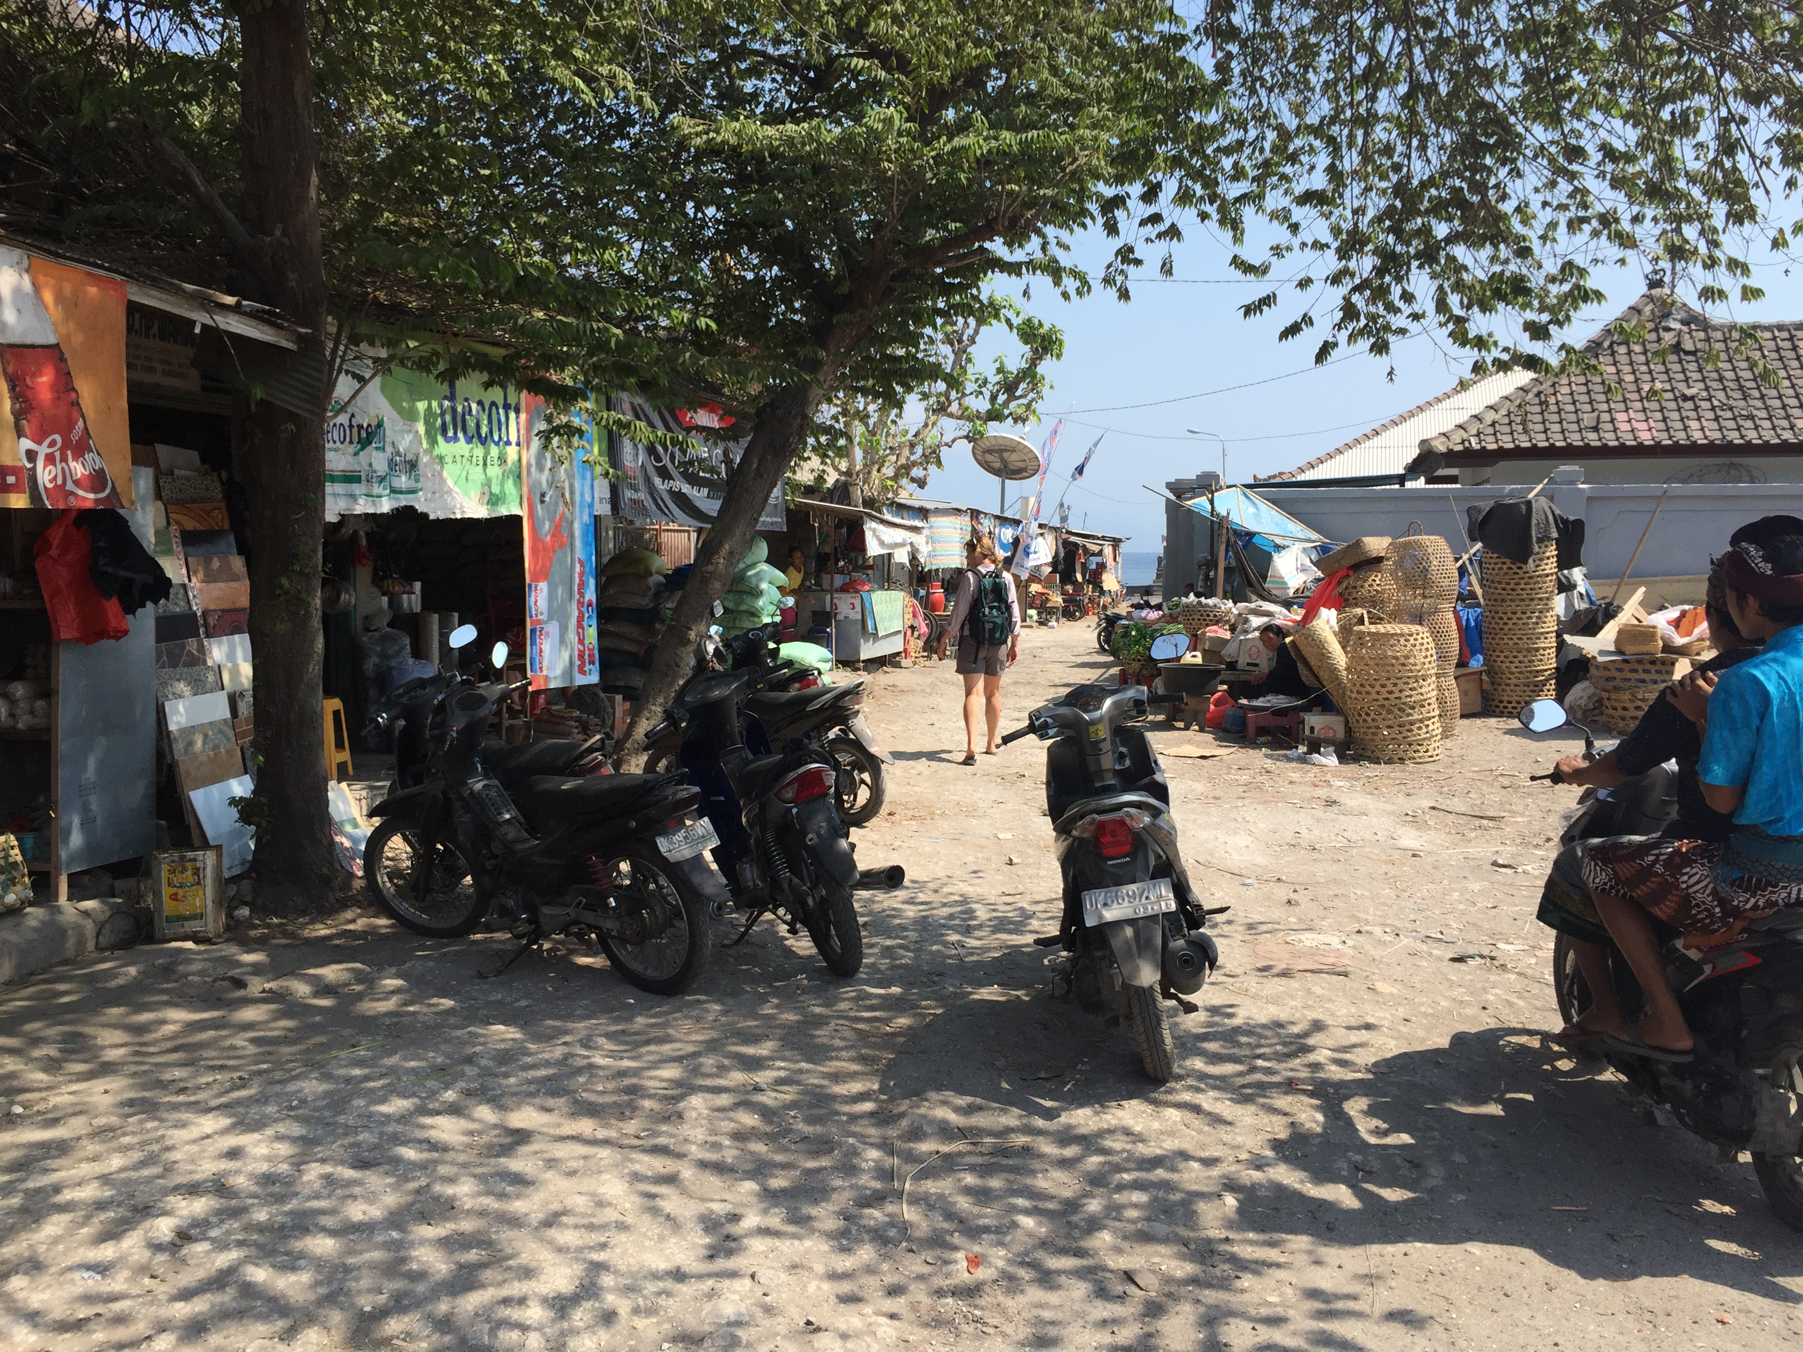
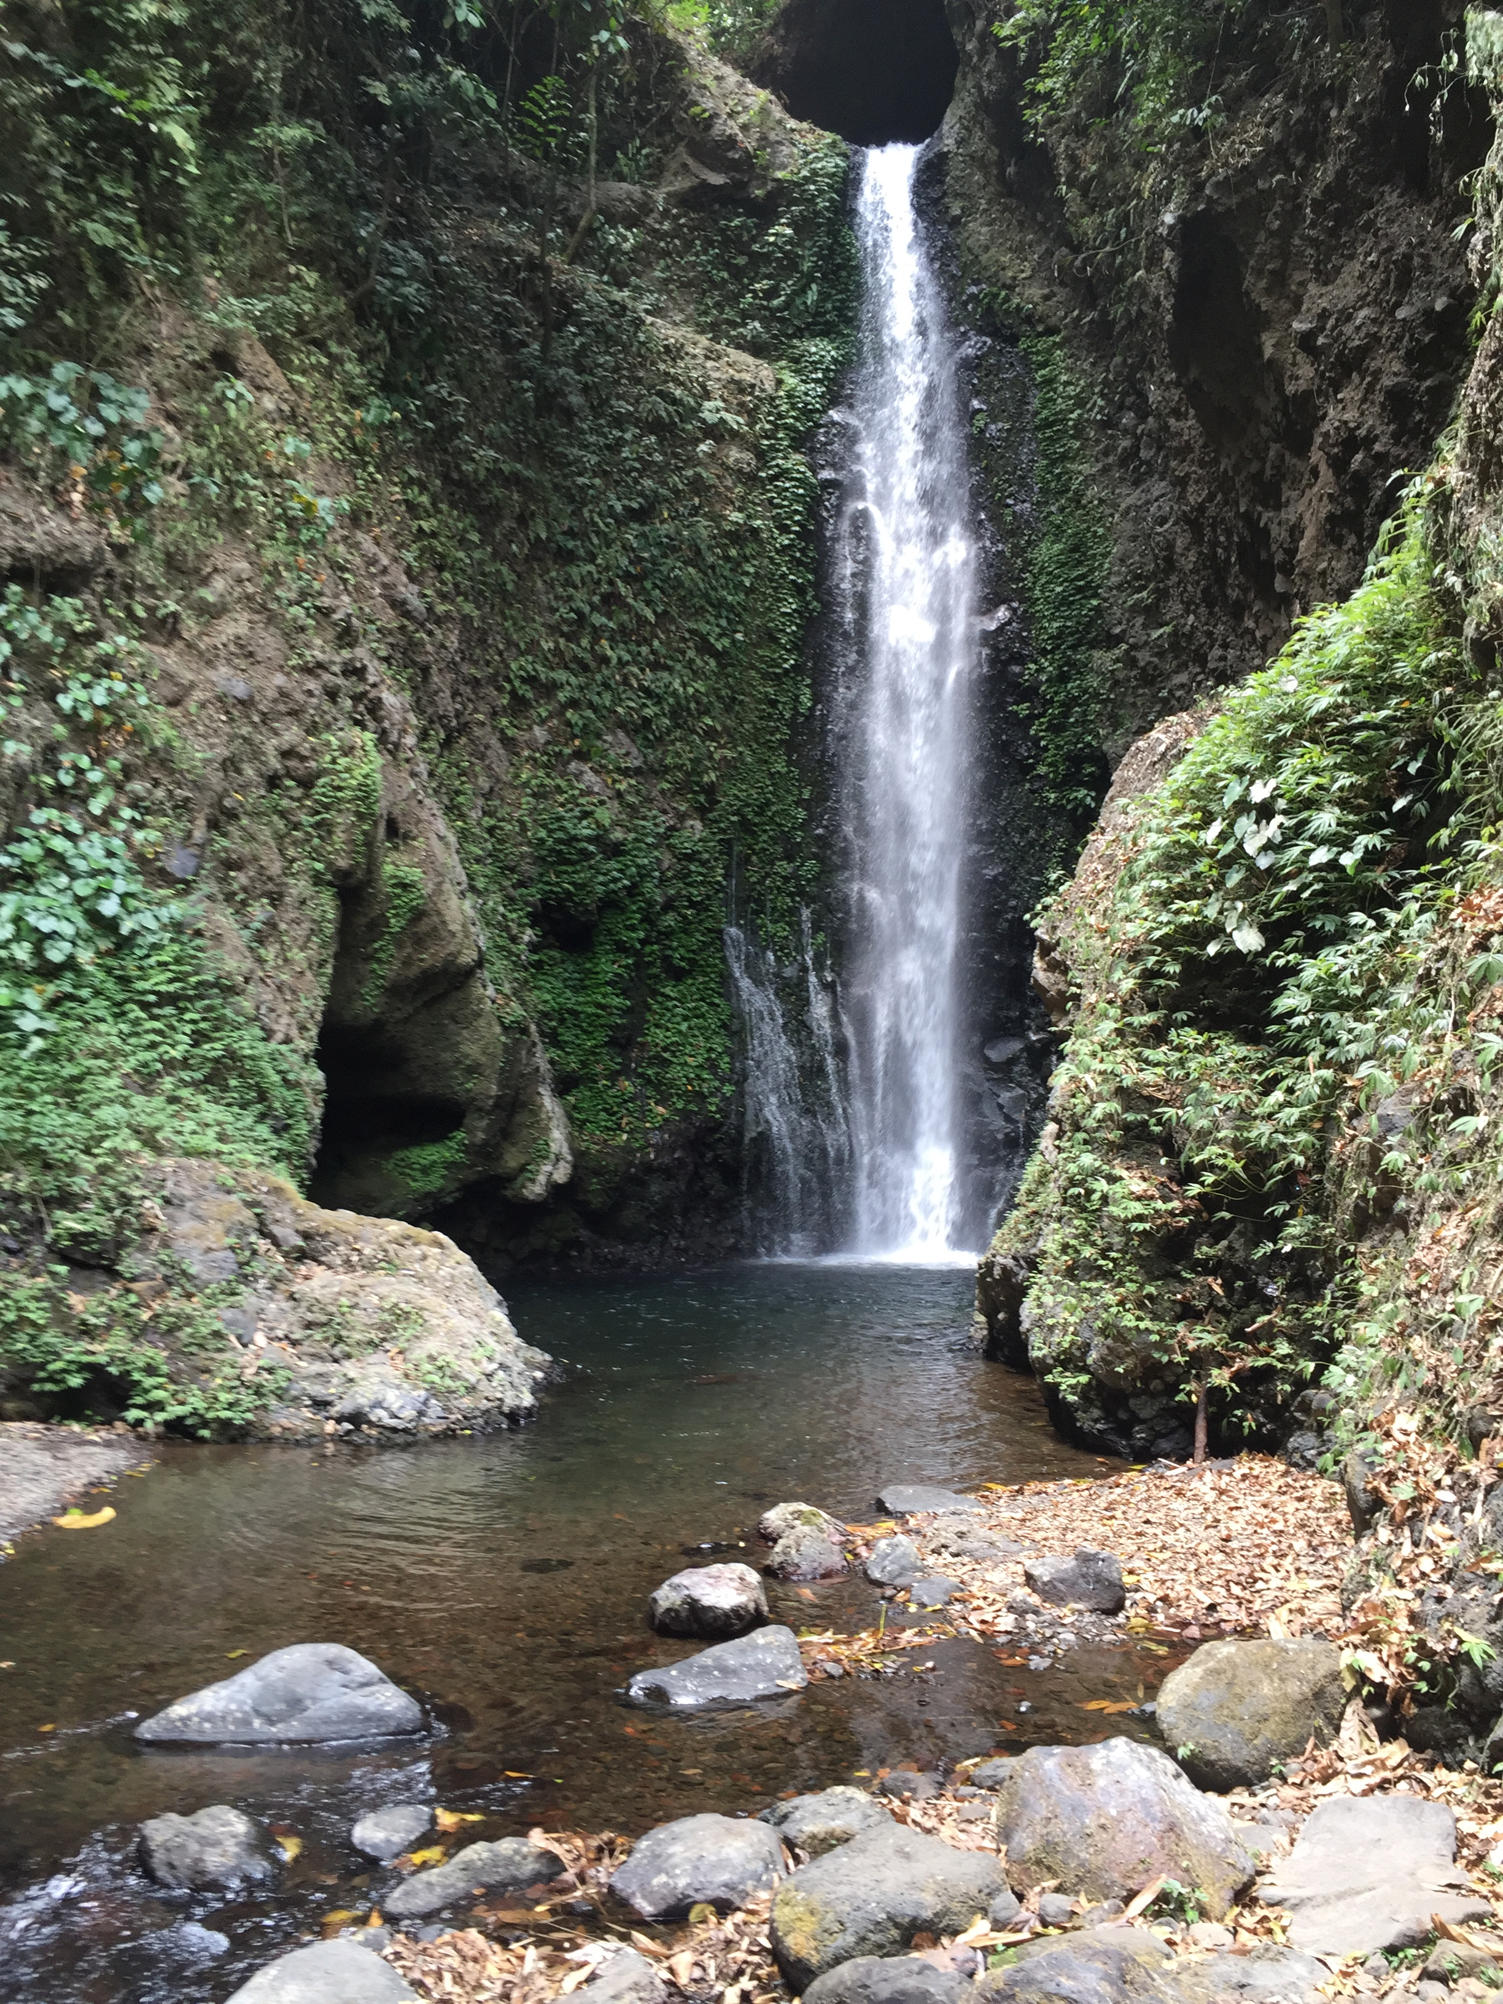
Drew’s story

Slide 28
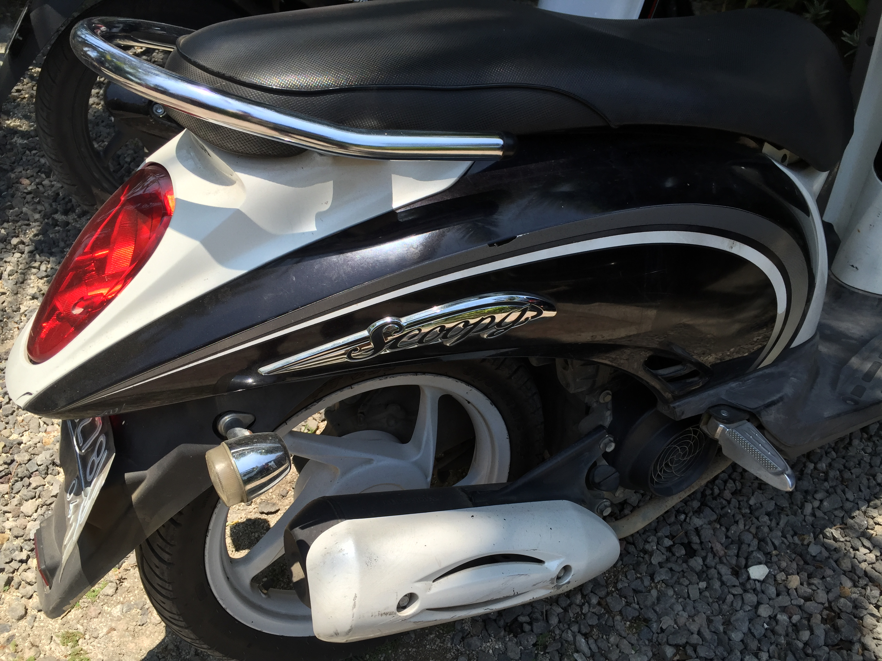
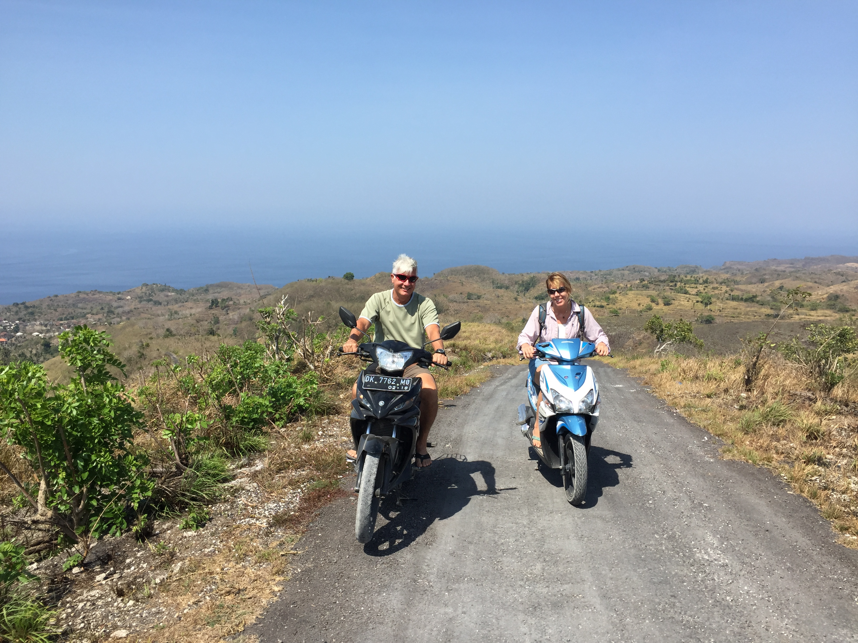
Drew’s story

Slide 29
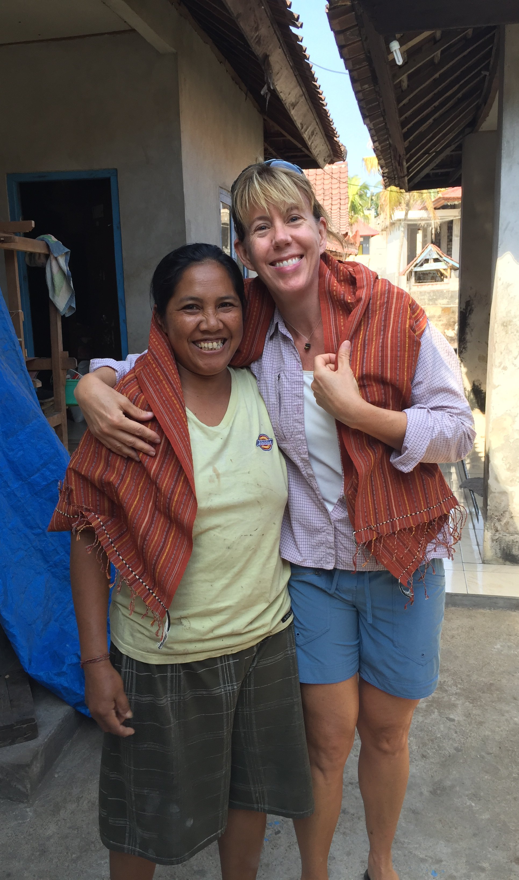
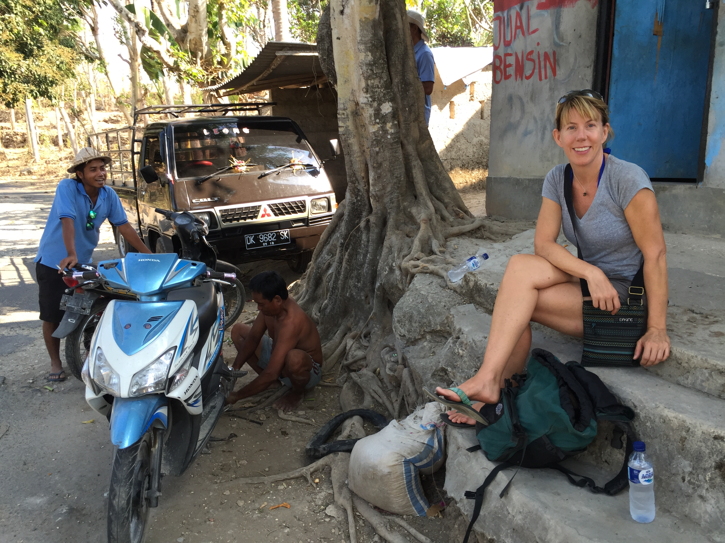
Drew’s story

Slide 30
Design Thinking
Problem: mainstream tours don’t feel like a real journey
Outcome: see rural areas, personal connection with people
Off the beaten path
Drew & Kristy
Learn language
Orienteering
Backpack
Water filters
Ride a motorcycle
International license
Fishing
Language lessons
Motorcycle course
Water filter research

Slide 31
Design Thinking
Problem: mainstream tours don’t feel like a real journey
Outcome: see rural areas, personal connection with people
Off the beaten path
Couldn’t learn language
Loved motorcycling
Criteria for filters
Problem: Getting to remote areas is difficult
Outcome: see rural areas, personal connection with people
Drew & Kristy
Learn language
Orienteering
Backpack
Water filters
Ride a motorcycle
International license
Fishing
Learn language
Orienteering
Backpack
Water filters
Ride a motorcycle
International license
Fishing
Language lessons
Motorcycle course
Water filter research

Slide 32
Try it.

Slide 33
Yes, and…
Notes:
So back to the title of the talk

Slide 34
I’m going on a trip and…

Slide 35

Notes:
With lots of ideas piling up it can feel like a full canapy of leafs

Slide 36
Reflect on a specific trip.

Slide 37
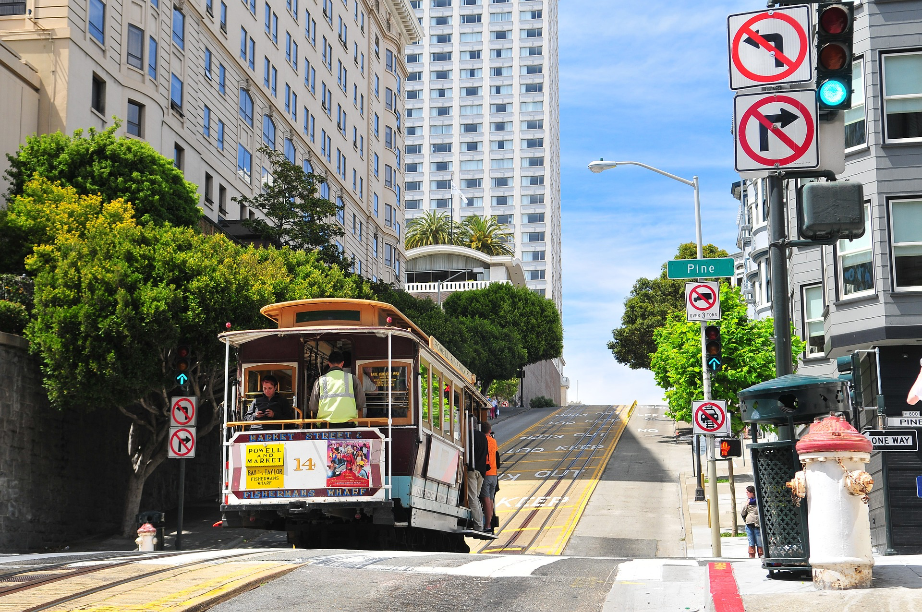

Slide 38
Why did you take that trip?
Write down your thoughts.

Slide 39
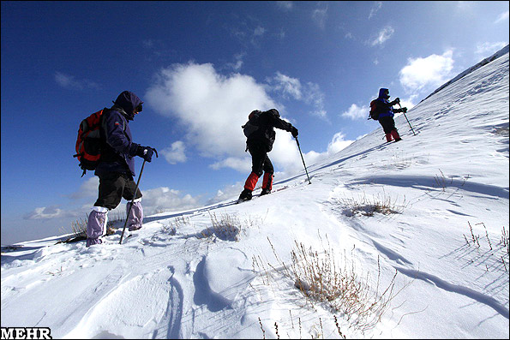
Notes:
Really reflect, because it’s there sure but that is not the big T truth about why.

Slide 40
Ask why again.
Discuss in pairs.

Slide 41
Write down your new insight.

Slide 42
Surprises?

Slide 43

Plan a new trip.
Notes:
Well there are all kinds of trips

Slide 44
Plan a new trip.

Slide 45
Who is going on this trip?

Slide 46
Reflect, why take this trip?
Is this the same for everyone?

Slide 47
Write down your insight.

Slide 48
Frame your story.
Scenario, press release, facebook post

Slide 49
Define outcomes of your trip.
Snapshots, family or friend dynamics, personal growth.

Slide 50
Share insights, story, & outcomes.
Discuss in group of 4.

Slide 51
Revise your story & outcomes.
(Align with all travellers)

Slide 52
Brainstorm ideas.
Discuss in group of 4.
Reversal, wild ideas, new math.

Slide 53
List 4-10 ideas to try.

Slide 54
Plan to prototype 2 ideas.
Discuss in pairs.

Slide 55
Decide how you will get feedback.
Discuss in pairs

Slide 56
Share your ideas.
Discuss in group of 4.

Slide 57
Design Thinking
INSIGHT and FEEDBACK
FRAME with OUTCOMES
FOCUS
BUILD
BRAINSTORM

Slide 58
Reflect, write up one takeaway.
Write on sticky note, put up on boards to share.

Slide 59


Slide 60
Thank you.
Jeanine Spence
Experience Strategist
Current Associates & The SFE Group
jeanine@currentassociates.com
www.sfeinfo.com

